Slide 1

Visualizing the trends of CO2 emissions
CIS 568/DS 530-Data Visualization
Sathvik Reddy Kandi - 01933878
Sai Surya Nattuva - 01934149
Pavan Kumar Panjala - 01872582
Priyanka Kokkula - 01991135

Slide 2
What?

Slide 3
C0₂ Emissions
Analysis of CO2 emissions, it’s correlation with population and impact of external factors like increase of power generation from renewable sources of energy.

Slide 4
Introduction
Carbon dioxide emissions will be mapped on a choropleth map of the United States. We will be using sequential colour palette to represent the CO₂ emission of each state.
We took Four sources of data
US population data
CO2 emission/state
Electricity power generation from different natural sources
US state topology data
Data Processing : we have formatted and parsed the data into appropriate data types and also created transpose of the data matrices for ease in visualizations.

Slide 5
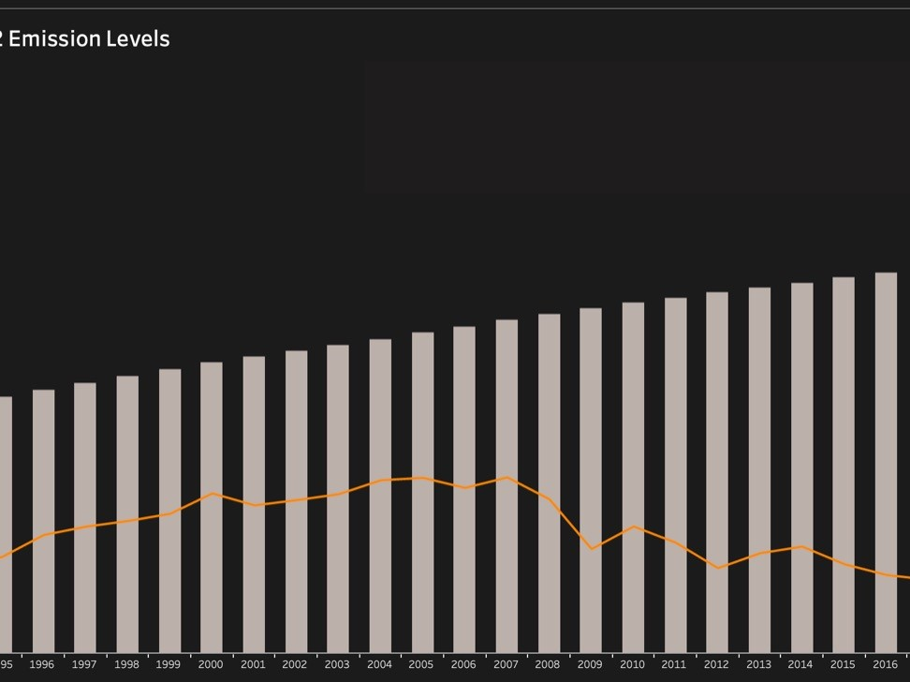
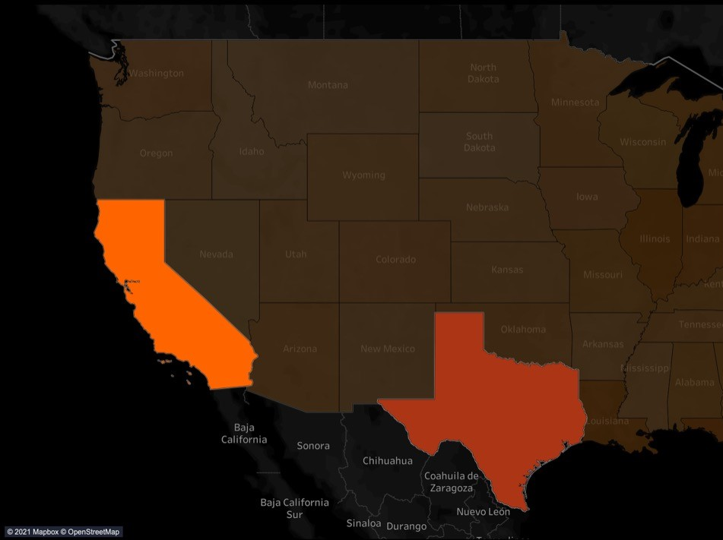
Draft Design
We would like to provide a prediction of the impact of the shift towards renewable sources of energy on the trend of CO₂ emissions.
So, these designs show our previous works which we designed during phase-b stage using tableau.

Slide 6
Expected outcomes
We expect to see positive correlation between population and CO₂ emissions
As two of the most heavily populated states, Texas and California are expected to have the highest CO₂ emissions.
We expect to see smaller states like the New England states with the smallest populations having the lowest emission levels.
We also expect to see strong correlation between coal related electricity generation and CO₂ emissions.

Slide 7

why?

Slide 8
Data description
Geospatial visualization - The dataset contains topology of 49 states of the United States of America.
Link to this dataset : https://catalog.data.gov
Bar chart visualization – the dataset contains population data from 2000 – 2018 and data of CO₂ emissions during the same time span.
Link to this dataset : https://www.census.gov
Line chart visualization – the dataset contains data of electricity generated from multiple resources between 1990 – 2020. The data of electricity generation using coal is in million metric tons.
Link to this dataset : https://www.eia.gov

Slide 9
We had all the data sources in the following format -
Rows - states
Columns - measurement for each year from 2000-2018
Features:
USA Population data – year, population/state, population total, population/region
CO₂ emissions – year, emissions/state, total emissions, emissions/region
Electricity generation data – year, electricity generation sources : coal, natural gas, nuclear, renewables, petroleum and others.,

Slide 10
Types of visualizations
A Geospatial map portraying the CO₂ emissions from all the states in USA from 2000-2018
Bar chart which shows CO₂ emissions declined from 2006
Line chart visualization which shows the coal used over the years to produce the energy in USA

Slide 11
Marks and channels
Our dataset contains several attributes such as states, years, different numbers of varying units
Geospatial
Marks – Geospatial Map of USA
Channels – Color scale
Bar chart
Marks –
Shapes(areas) for population
Lines for emissions
Channels
Length for population
Position for emissions
Line chart
Marks – point, line
Channels - Position

Slide 12

how?

Slide 13
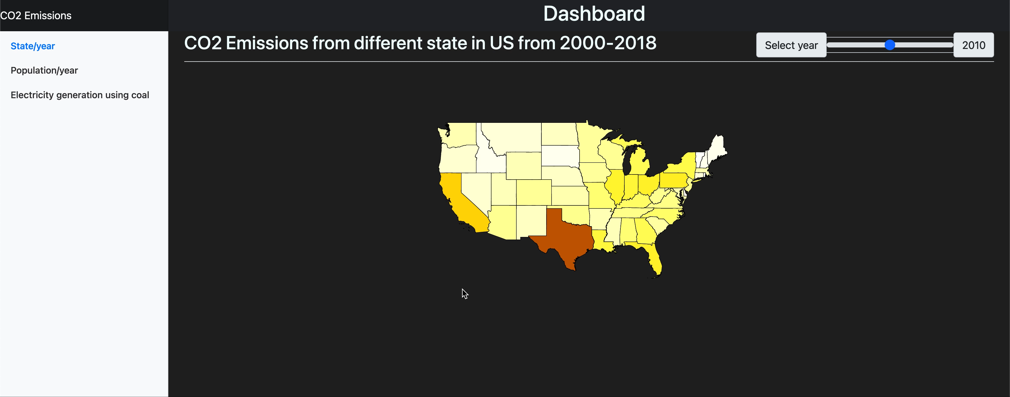
Geospatial Visualization
On mouse hover, we will be able to see the CO2 emissions of each state with population.
A slider will be provided to view historical data of population and CO2 emissions.

Slide 14
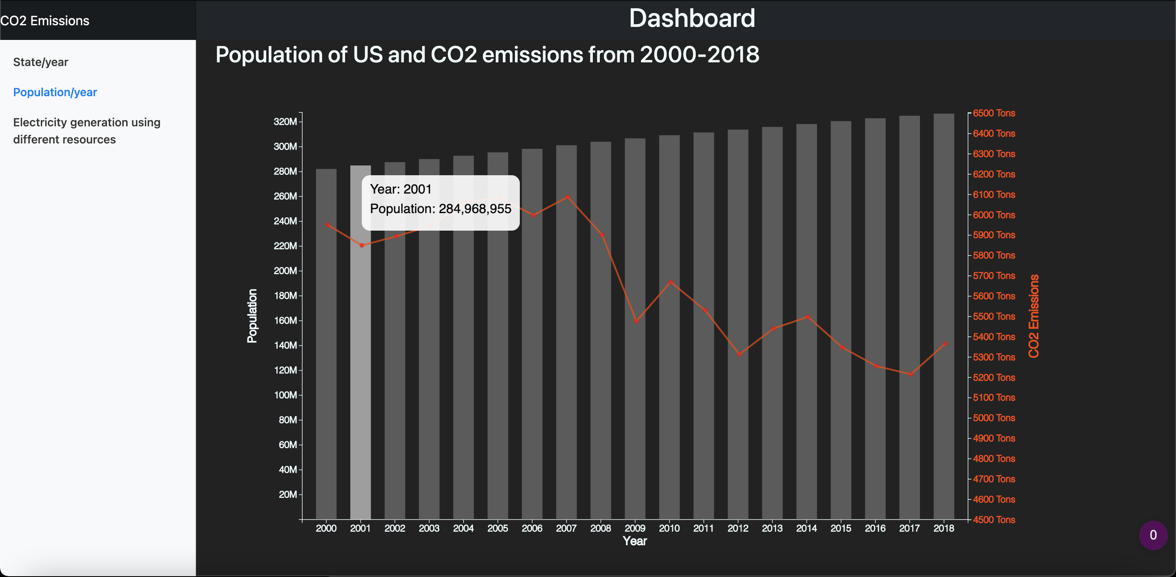
Bar chart visualization

Slide 15
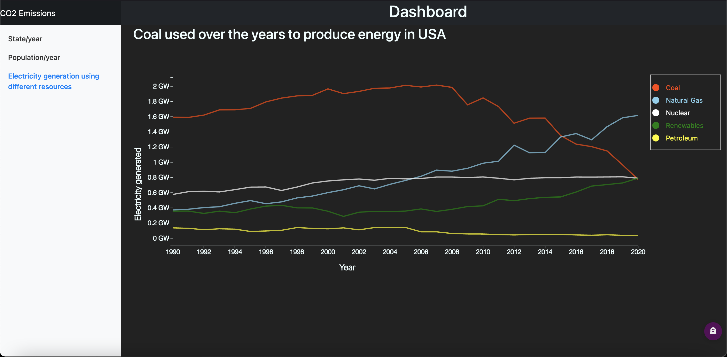
Line Chart Visualization

Slide 16
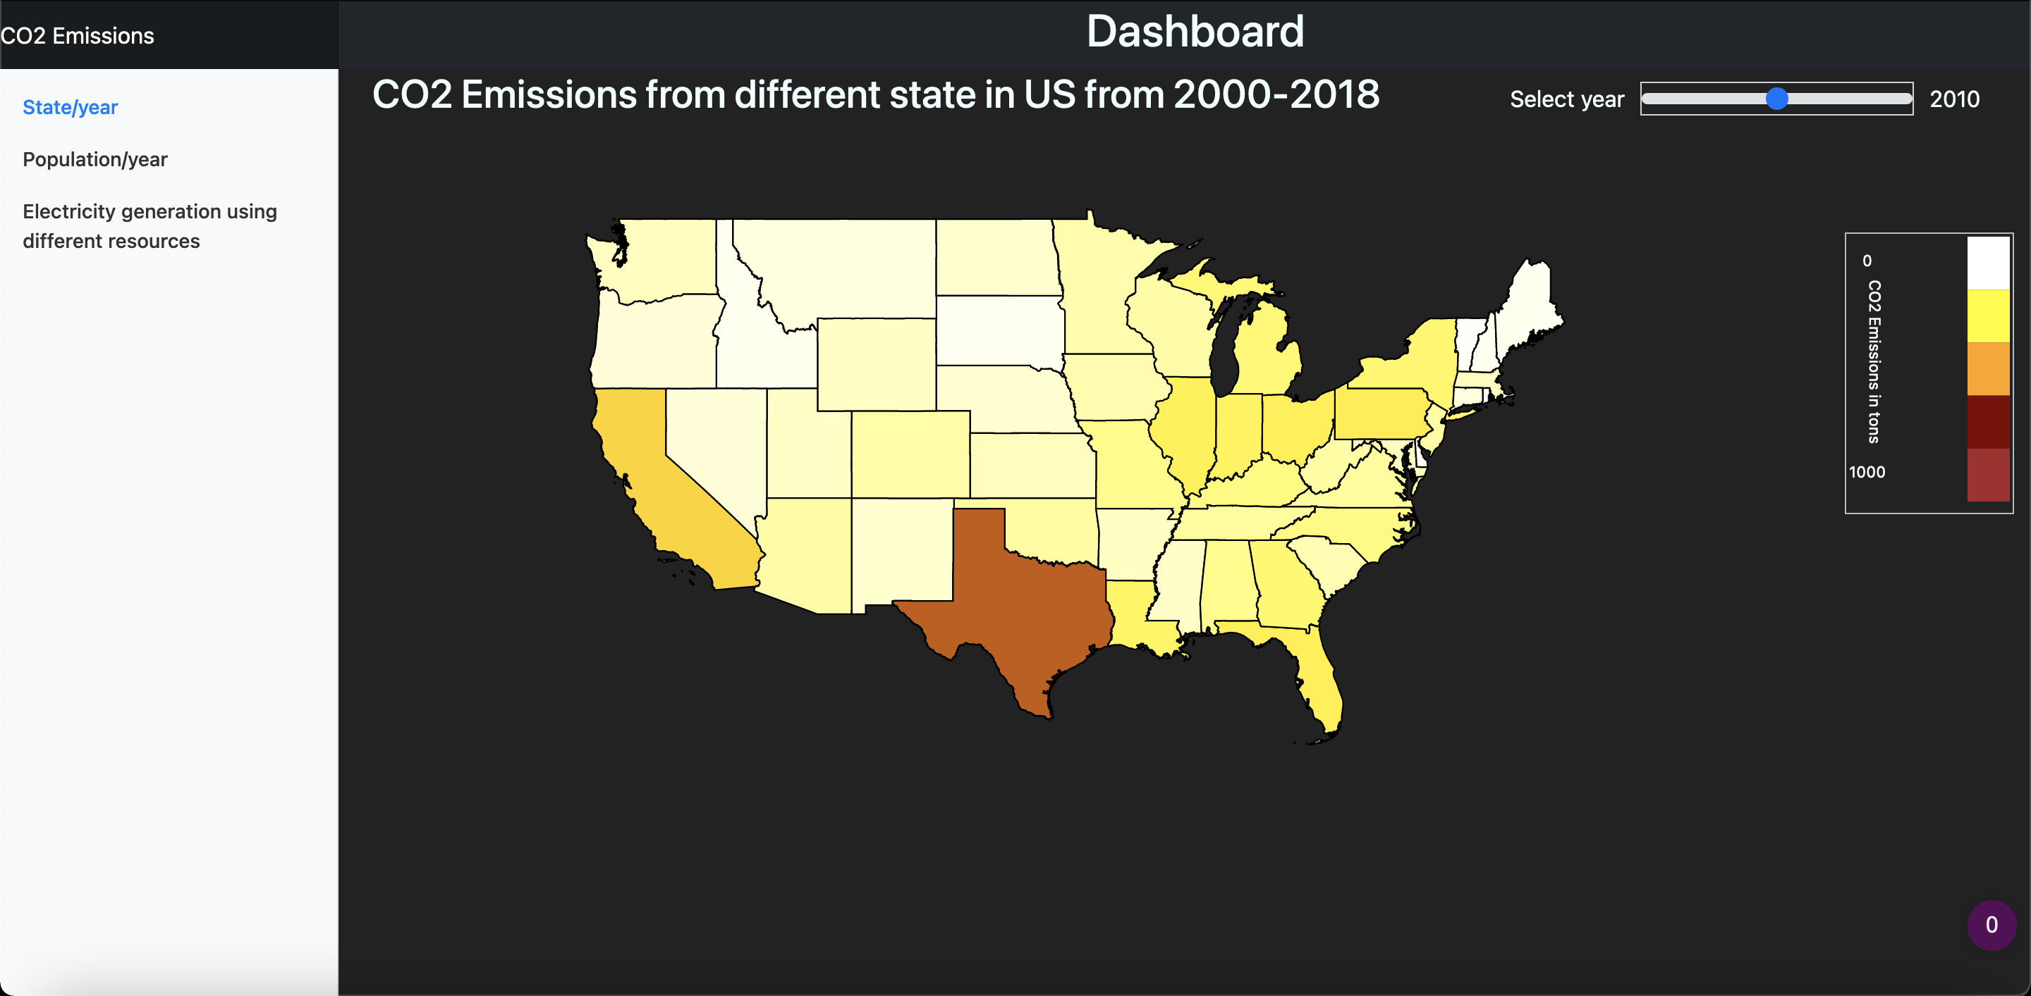
Webpage Design

Slide 17
Data sources
https://www.eia.gov
https://www.census.gov
https://catalog.data.gov

Slide 18
Thank you

